Slide 1
Finding Bridges in an Undirected Graph
Presented by : Awaiz Noor

Slide 2
Table of Contents
Introduction
Problem Statement
Tarjan Algorithm
Code Demo

Slide 3

Introduction

Slide 4
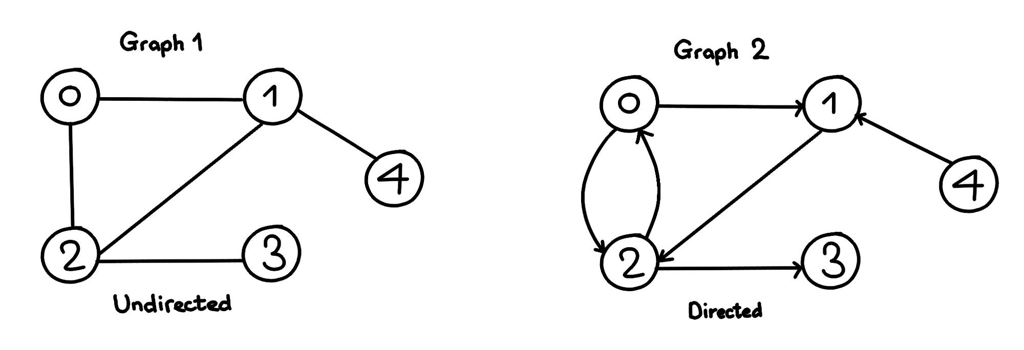
Graphs
A graph G is a collection of Vertices (Nodes) and edges.
Mathematical Definition: A graph is defined G=(V,E) where V = {1,2,3,...n} is the set of vertices and E = { (u,v) ∣ u,v ∈ V } is the set of edges.
Undirected Graph ((u,v)=(v,u)) : Edges have no specific direction
Directed Graph ((u,v) ≠ (v,u)): Edges have a direction
Notes:
https://medium.com/data-science/graph-data-structure-cheat-sheet-for-coding-interviews-a38aadf8aa87

Slide 5
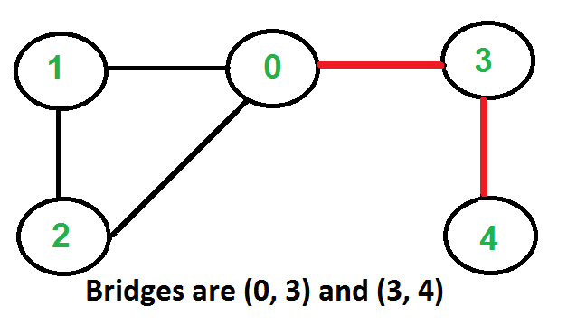
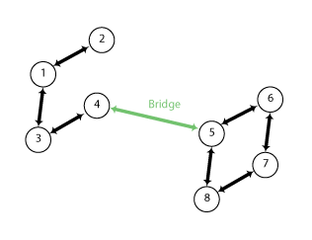
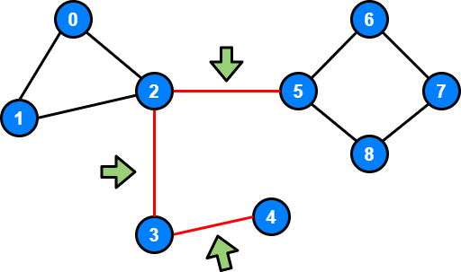
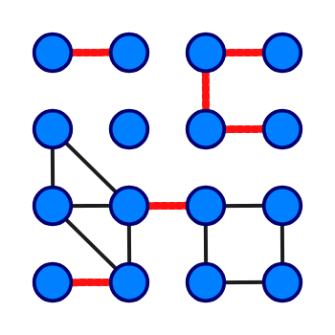
Bridges
An edge in a graph G = (V, E) is a bridge if its removal will increase the number of connected components of G.
Notes:
https://www.thealgorists.com/Algo/GraphTheory/Tarjan/Bridges https://en.wikipedia.org/wiki/Bridge_%28graph_theory%29 https://www.geeksforgeeks.org/bridge-in-a-graph/
https://stackoverflow.com/questions/48434050/in-a-graph-how-do-you-determine-if-two-vertices-form-a-bridge-and-which-vertice

Slide 6

Problem Statements
Implement the algorithm that finds the bridges in an undirected graph.

Slide 7
Naive Approach
One by one remove all edges and see if the removal of an edge can causes an increase in number of connected components of G.
For every edge (u, v), do the following:
Remove (u, v) from the graph
See if the graph remains connected (either uses BFS or DFS)
Add (u, v) back to the graph.
Time Complexity: O(E*(V+E)) for a graph represented by an adjacency list.
Auxiliary Space: O(V+E)

Slide 8
Naive Approach
Function findBridges(graph):
bridges = []
for each edge (u, v) in graph:
removeEdge(graph, u, v)
# Check if the graph remains connected using DFS/BFS
visited = set()
start_node = any remaining node in graph
DFS(graph, start_node, visited)
# If some nodes are not visited, the graph is disconnected => (u, v) is a bridge
if len(visited) < total number of nodes:
bridges.append((u, v))
# Add edge (u, v) back
addEdge(graph, u, v)
return bridges

Slide 9
Tarjan Algorithm
Enhancing your presentation

Slide 10
Tarjan Algorithm
Tarjan's algorithm for finding bridges in a graph is a DFS-based algorithm that identifies edges whose removal increases the number of connected components, using discovery and Lowest reachable ancestor values in O(V + E) time.
To implement this algorithm, we need the following data structures:
visited[ ] = to keep track of the visited vertices to implement DFS
discovery[ ] = to keep track when for the first time that particular vertex is reached
Low[ ] = to keep track of the lowest possible time by which we can reach that vertex ‘other than parent’ so that if edge from parent is removed can the particular node can be reached other than parent.
An edge (u, v) is a bridge if Lowest_reachable_ancestor[v] > discovery[u]
This means that v cannot reach an ancestor of u, implying that removing (u,v) disconnects the graph.

Slide 11
Tarjan Algorithm
Function findBridges(graph, n):
time = 0
bridges = []
disc = [-1] * n # Discovery time of nodes
low = [-1] * n # Lowest discovery time reachable
visited = set()
Function DFS(graph, u, parent):
# Assign discovery time and low value
disc[u] = low[u] = time
time = time + 1
visited.add(u)
for each v in graph[u]: if disc[v] == -1: # If v is unvisited
DFS(graph, v, u)
# Update low[u] based on subtree
low[u] = min(low[u], low[v])
# If low[v] > disc[u], edge (u, v) is a bridge
if low[v] > disc[u]:
bridges.append((min(u, v), max(u, v)))
elif v != parent: # If v is visited and is not parent
low[u] = min(low[u], disc[v]) # Update low value for back edge
for each node u in range(0, n):
if disc[u] == -1:
DFS(graph, u, -1)
return bridges

Slide 12





Example
$$\frac{3}{3}$$
C
Discovery
$$\frac{1}{1}$$
$$\frac{2}{2}$$
$$\frac{4}{4}$$
Low
A
B
D
E
$$\frac{5}{5}$$
Notes:
https://codeforces.com/blog/entry/71146

Slide 13

Example
$$\frac{3}{3}$$
C
Discovery
$$\frac{1}{1}$$
$$\frac{2}{2}$$
$$\frac{4}{4}$$
Low
A
B
D
E
$$\frac{5}{2}$$

Slide 14

Example
$$\frac{3}{3}$$
C
Discovery
$$\frac{1}{1}$$
$$\frac{2}{2}$$
$$\frac{4}{2}$$
Low
A
B
D
E
$$\frac{5}{2}$$

Slide 15

Example
$$\frac{3}{2}$$
C
Discovery
$$\frac{1}{1}$$
$$\frac{2}{2}$$
$$\frac{4}{2}$$
Low
A
B
D
E
$$\frac{5}{2}$$

Slide 16
Example
$$\frac{3}{2}$$
C
Discovery
$$\frac{1}{1}$$
$$\frac{2}{2}$$
$$\frac{4}{2}$$
Low
A
B
D
E
$$\frac{5}{2}$$

Slide 17





Example
An edge (u, v) is a bridge if :
Lowest_reachable_ancestor[v] > discovery[u]
Edge (A,B) : 2 > 1 is a bridge
Edge (B,C) : 2 > 2 not a bridge
Edge (C,D) : 2 > 3 not a bridge
Edge (D,E) : 2 > 4 not a bridge
Edge (E, B) : 2 > 5 not a bridge
$$\frac{3}{2}$$
C
$$\frac{2}{2}$$
$$\frac{4}{2}$$
A
B
D
$$\frac{1}{1}$$
Discovery
Low
E
$$\frac{5}{2}$$

Slide 18
Code Demo
https://github.com/Awaiz27/Bridges_in_Graphs

